Slide 1
JDS-6
Java Design Studio - 6
Instructor
Ryan Liu
dio.ryanliu@Hotmail.com

Slide 2
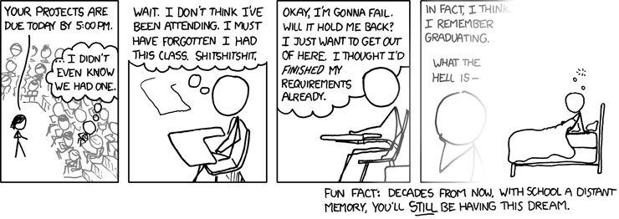
Homework
Goals and Progress
Notes:
Trello progress
Github progress
Ask about project progress
Check if they have achieved their goals and if they have not, ask them why not

Slide 3
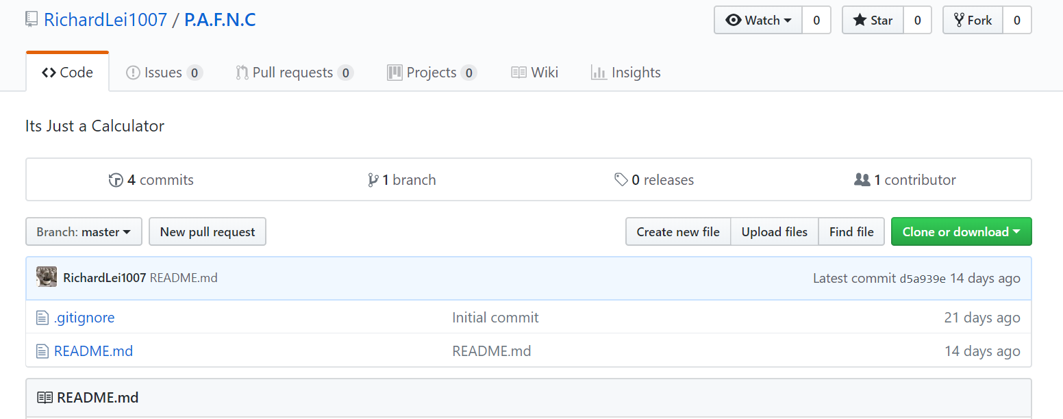
Progress?
Notes:
Where are the commits
Show me your trello

Slide 4
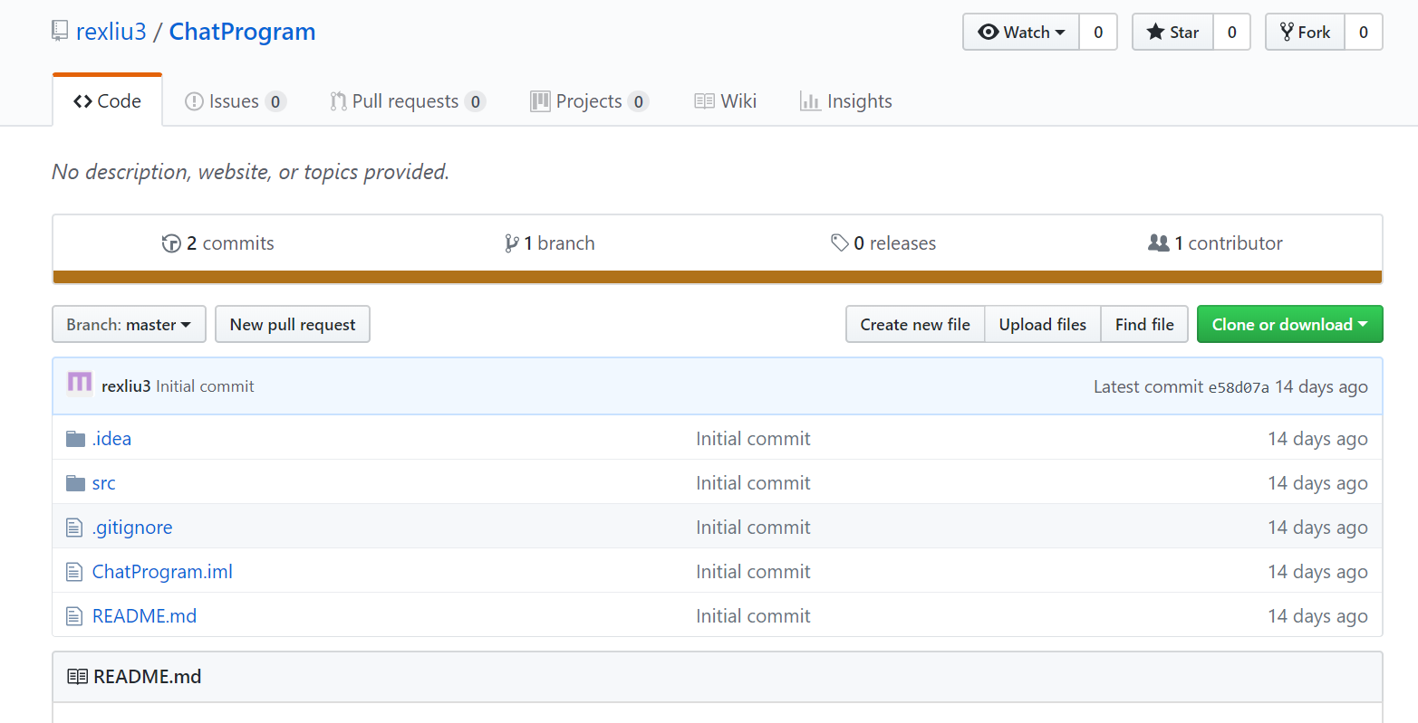
Progress?
Notes:
Where are the commits
Show me your trello

Slide 5
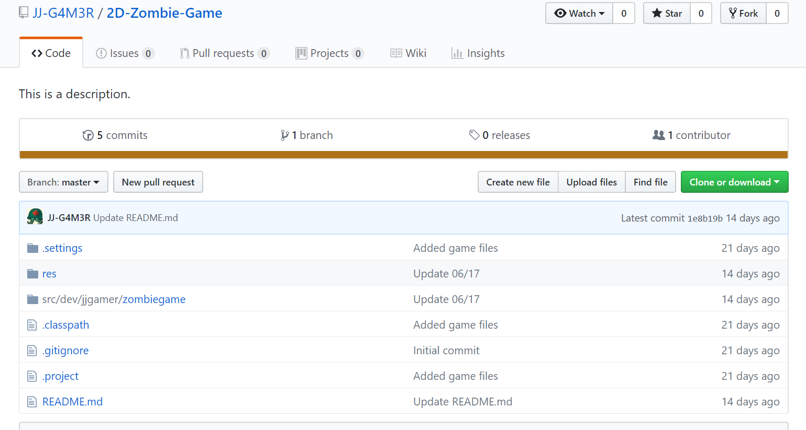
Progress?
Notes:
Where are your commits
Show me your trello

Slide 6
Progress?
Where’s your GitHub and Progress Goals Jimmy?
I have asked you every single class for 3 weeks
Where’s your commits?
Where’s your Trello?

Slide 7
Testing
Unit Tests
Component Tests
Integration Tests
System Tests
Notes:
Different kinds of tests to accomplish different types of requirements
Unit tests are used for testing individual classes via testing the functions to see what they output based on given input
Component Tests involves testing of multiple functionalities as a single code and its objective is to identify if any defect exists after connecting multiple functionalities with each other
Tests all integrated modules to verify the combined functionality after integration is performed.
Entire system is tested per the set requirements – supposed to cover everything

Slide 8
Implementation
Test-driven development
Development based on Tasks
Prepare a plan before you head in
Do not Code before planning

Slide 9
End Of Class
Continue project
Don’t forget to keep up good practices!

